Slide 1
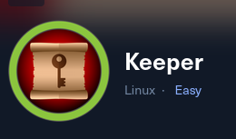
HTB machines - Keeper
Write up by Chanan shenker

Slide 2
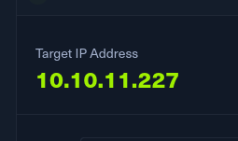

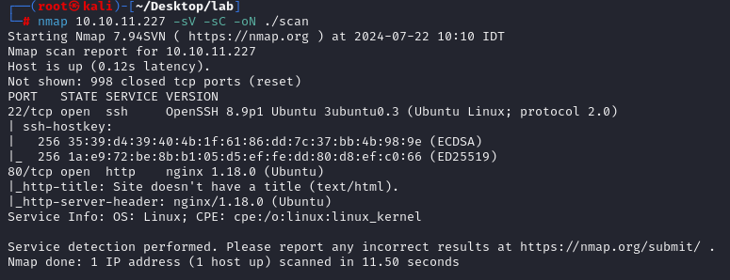
Start:
I connected to the VPN, turned on the machine and got an IP address to start.
Scanning:
I ran the command above and found two ports open on the target. Port 22 and 80.
Port 80 tells me that this is hosting a website, so lets go.

Slide 3
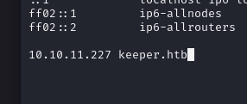
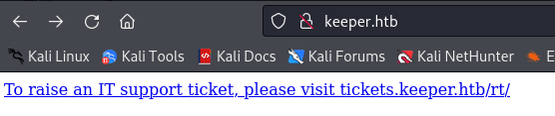
I added the machine to /etc/hosts.
And tried to access the webpage.
I clicked on the link and it redirected me to another page that is a subdomain of keeper.htb.

Slide 4
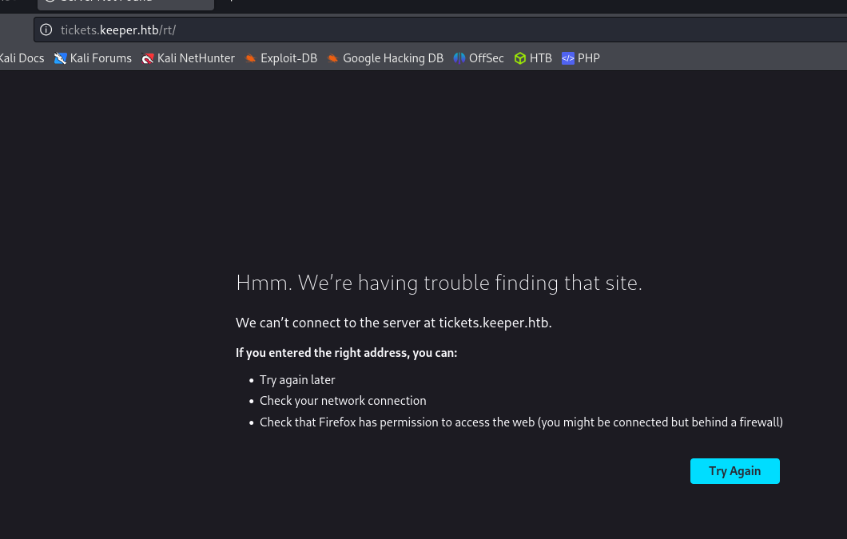

So i added the subdomain to /etc/hosts file and accessed it again.

Slide 5
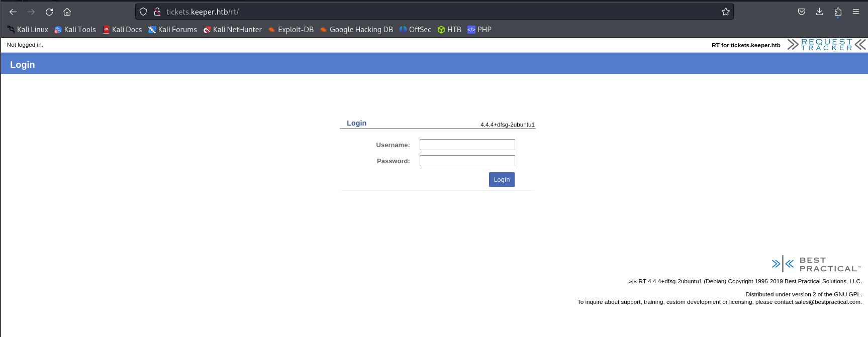
Viola, a login page for ‘best practical solutions ’, a ticket management system.
I couldn’t find anything to juicy about the software (like exploit, CVEs etc.) so I decided to try and crack the password. So I fire up burp suite.
Burp suite is a very popular tool used by penetration testers and has a wide variety of features to exploit wed applications

Slide 6
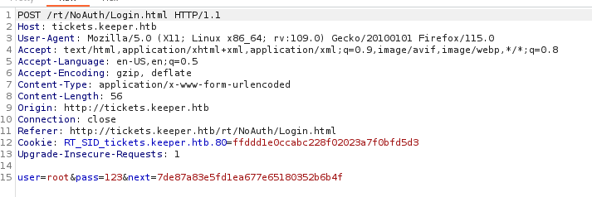
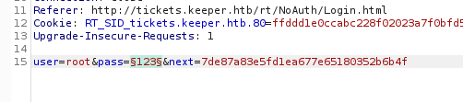
The tool ill use is called intruder. It work by capturing a request that I send out through the burp suite proxy and send it to the intruder so I can make it send the request over and over with different values each time. Obviously the value I would like to change is the password.
This is the captured request. Note the part at the bottom where is say user=<>&pass=<>.
So that the part I want to change every request.
the username ‘root’ I found out by a quick google search about default users for ‘Best practical solutions’ .

Slide 7
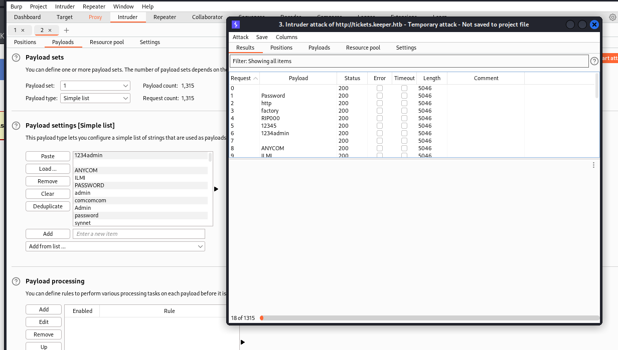
So I start the brute force attack.

Slide 8
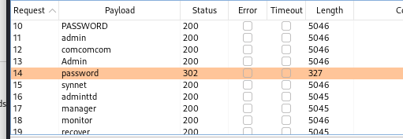
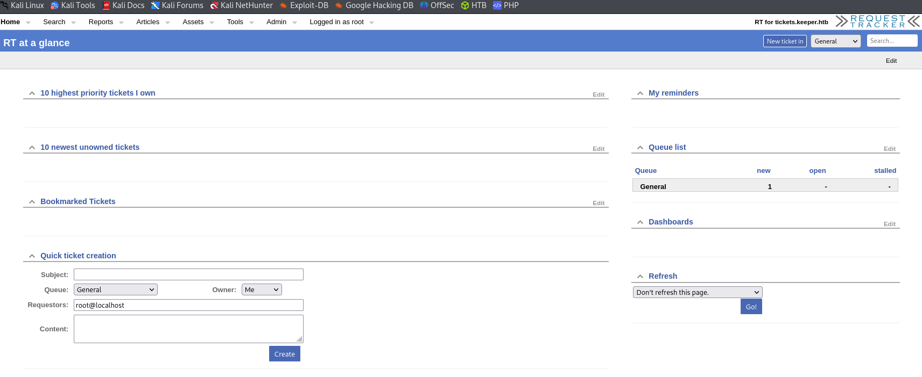
Now, the way we can figure out what password was successful we habe to look at the content length of the response it got.
Next to ‘password’ we get a much smaller content length in the response. Lets check if it’s the one.
And were in :)

Slide 9
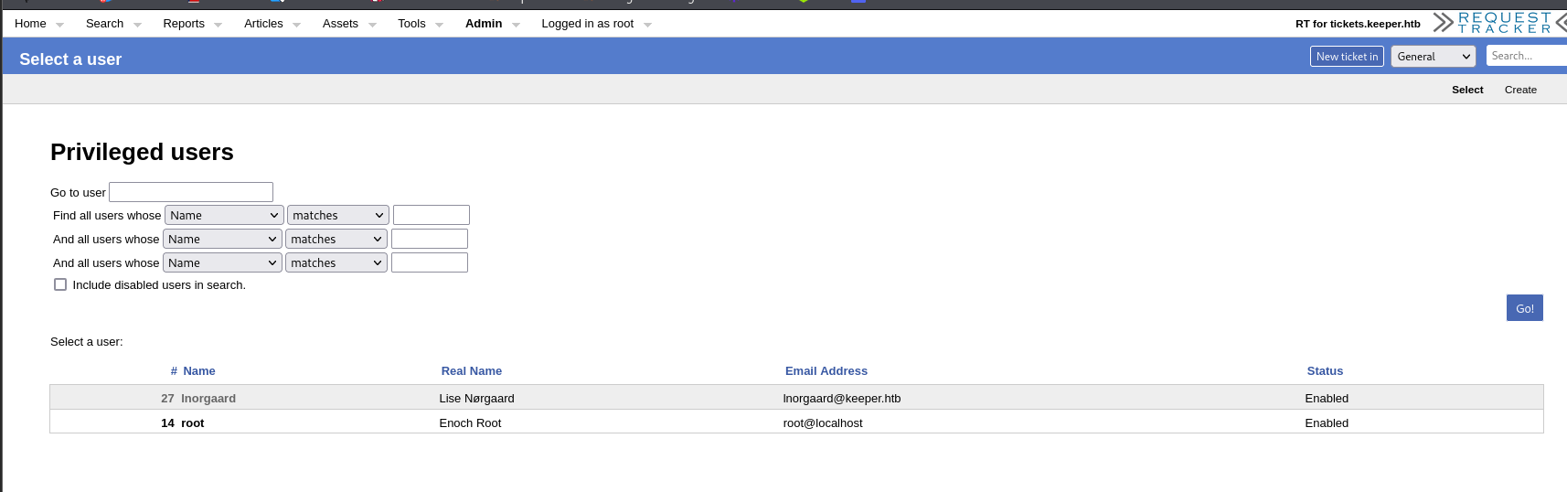
To my annoyance I discovered that those are the default credentials and could have save my self a lot of time if id just looked online, but hey we learned something.
Now lets dig. I couldn’t find anything interesting in the page but a little look around and I found under the admin > users tab this.
A tab with two users. One is root and had nothing interesting in it. And the other is lnoogaard.

Slide 10
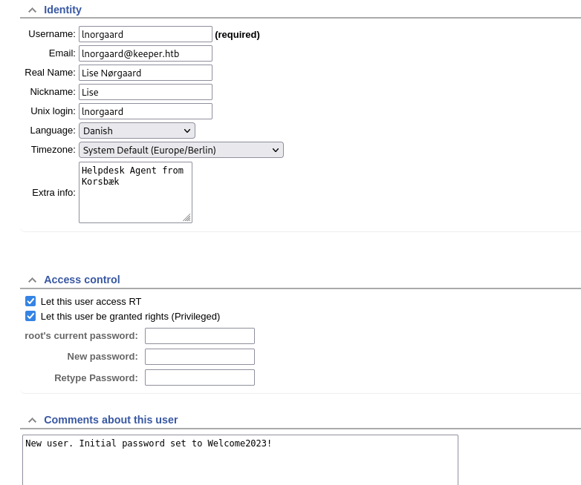
As we can see in his tab is a username and at the bottom a default password.
Remember on the nmap scan we found port 22/SSH open. So let try and login with lnorgaard’s credentials.

Slide 11
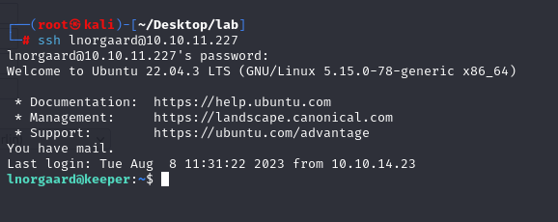
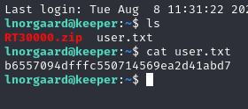
And boom we are in. a quick look in the users directory we find the flag and we can submit it.

